Slide 1

Healthcare AI Agent for Patient
Symptom Triage and Guidance
Team 7
- Naman Shrivastava
- Pranav Patni
- Divyansh Dharmadhakari
- Anshul Mishra
- Durva Shah
Created By AI

Slide 2

01
Introduction
02
Problem Context
Contents
03
Solution Overview
04
Design Diagram
05
Bot Response 1
06
Bot Response 2
07
Conclusion

Slide 3

Introduction
Imagine a world where every patient has instant access to reliable symptom guidance.
AI agents make this vision a reality—enhancing care, reducing strain,
and empowering smarter decisions.

Slide 4

Problem Context
In today’s healthcare environment, patients frequently face uncertainty when experiencing symptoms—unsure whether their condition warrants immediate medical attention or can be managed at home. This lack of clarity leads to two major issues:
Overutilization of emergency services: Many individuals visit emergency departments for non-urgent concerns, contributing to overcrowding, increased wait times, and resource strain on healthcare systems.
Delayed care for serious conditions: Conversely, some patients underestimate the severity of their symptoms, delaying necessary treatment and risking complications or adverse outcomes.

Slide 5
Solution overview
Our solution leverages cutting-edge AI to deliver intelligent symptom triage and guidance for patients, built with a focus on accuracy, accessibility, and scalability to deliver assisment, recommendation and explaination
Powered by OpenAI GPT-4.0 (via Oi AI Vast), enabling advanced natural language understanding and contextual reasoning for medical conversations.
We trained a custom medical knowledge base using trusted sources such as clinical textbooks which are referred by medical professionals.
🛠️ Tools Used
OpenAI models for language processing and inference
LangChain for orchestrating multi-step reasoning and tool integration
💻 Tech Stack
Python for backend logic, model integration, and data handling
React for responsive, user-friendly frontend design

Slide 6
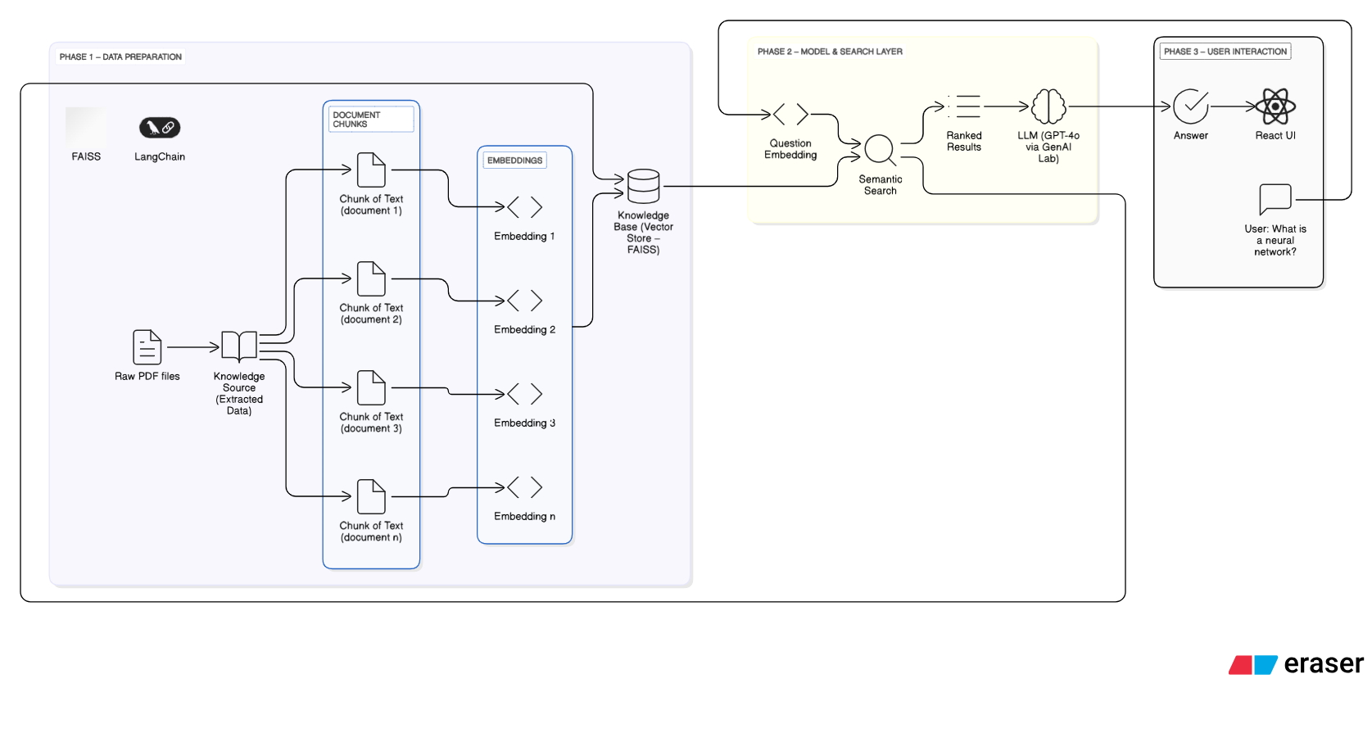
Design Diagram

Slide 7
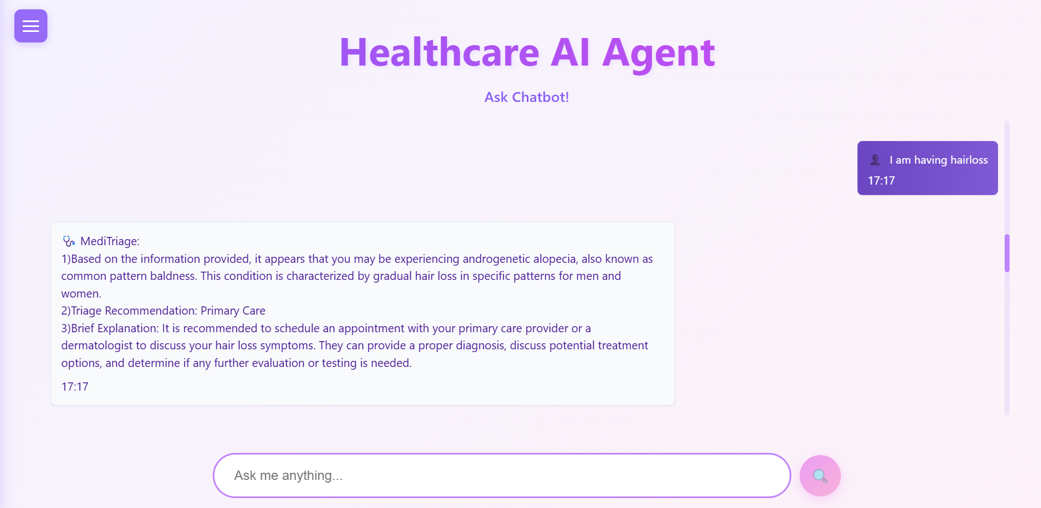
Relevant Response

Slide 8
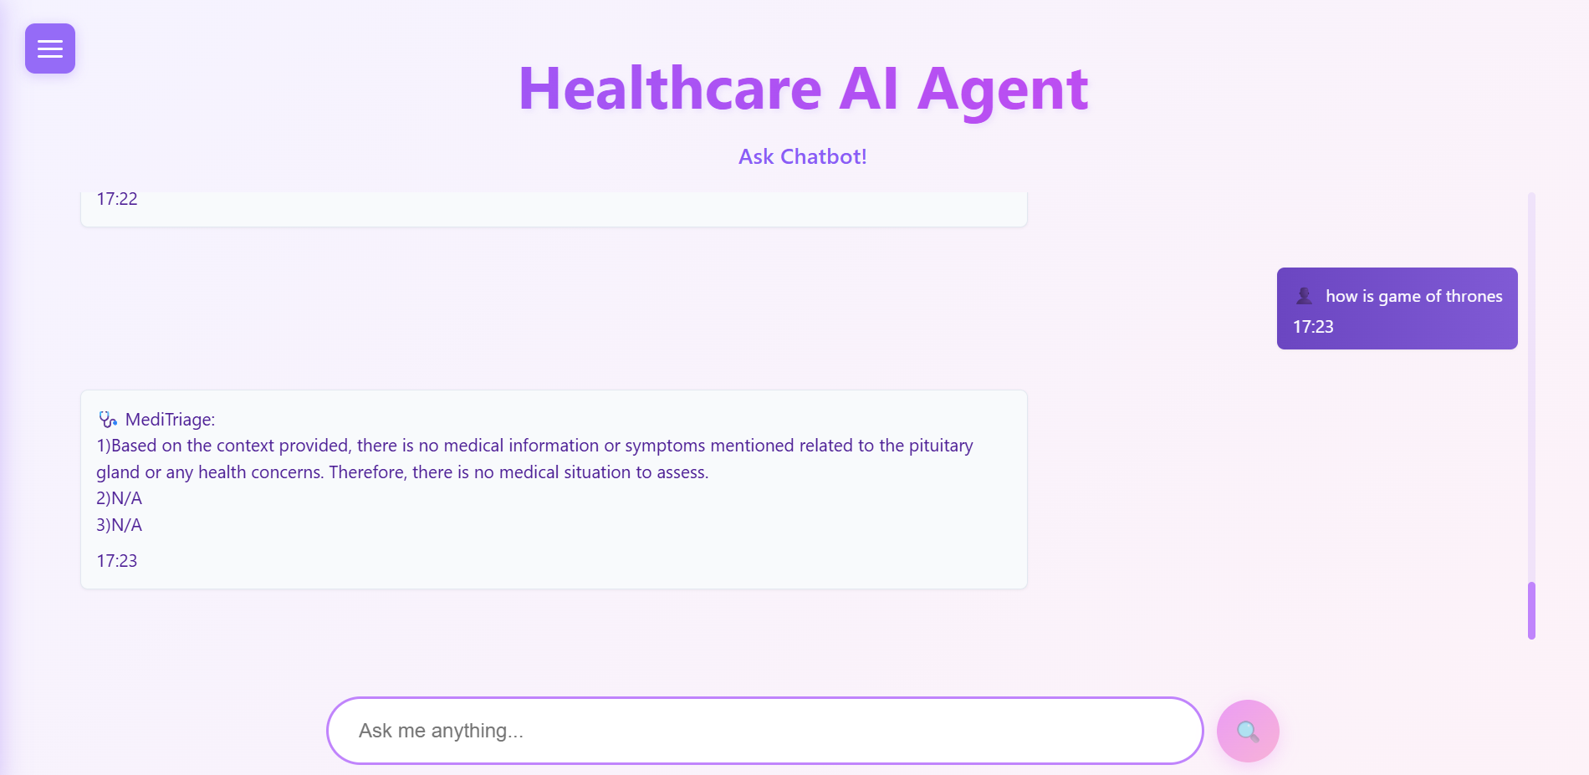
Irrelevant Response

Slide 9
Thank you for watching.

